Slide 1
Arduino/Pi Session
Colleague Education Series
February 2014
V1.0
Company confidential

Slide 2
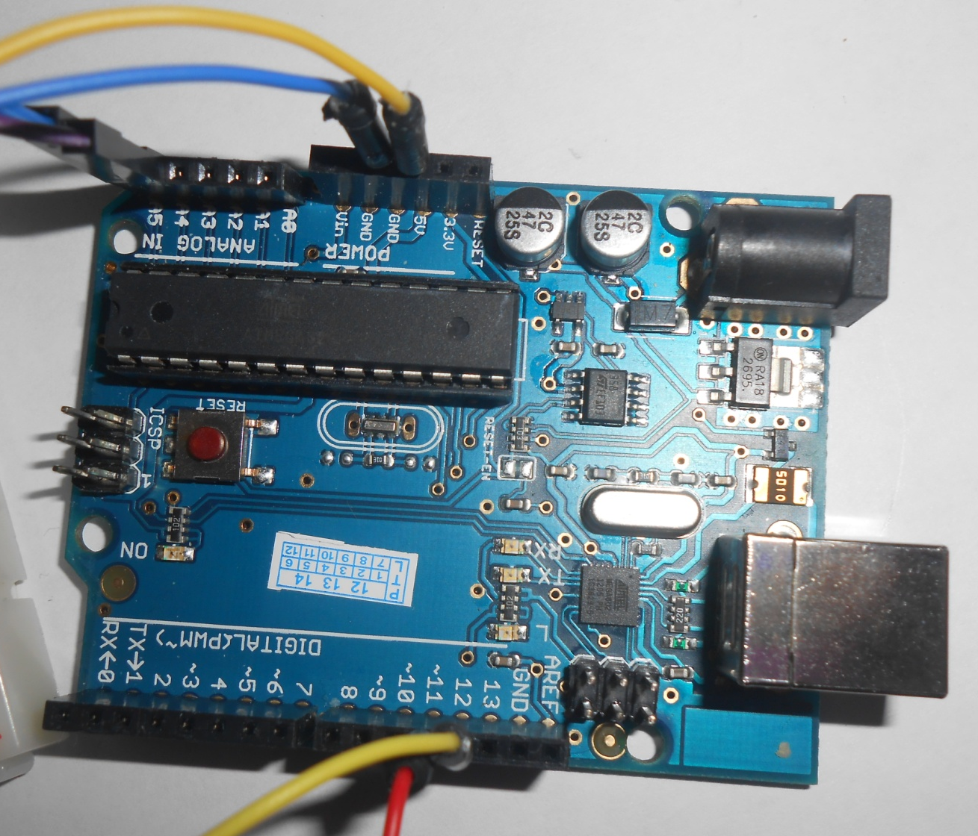
Build a Parking Sensor – Arduino Board

Slide 3
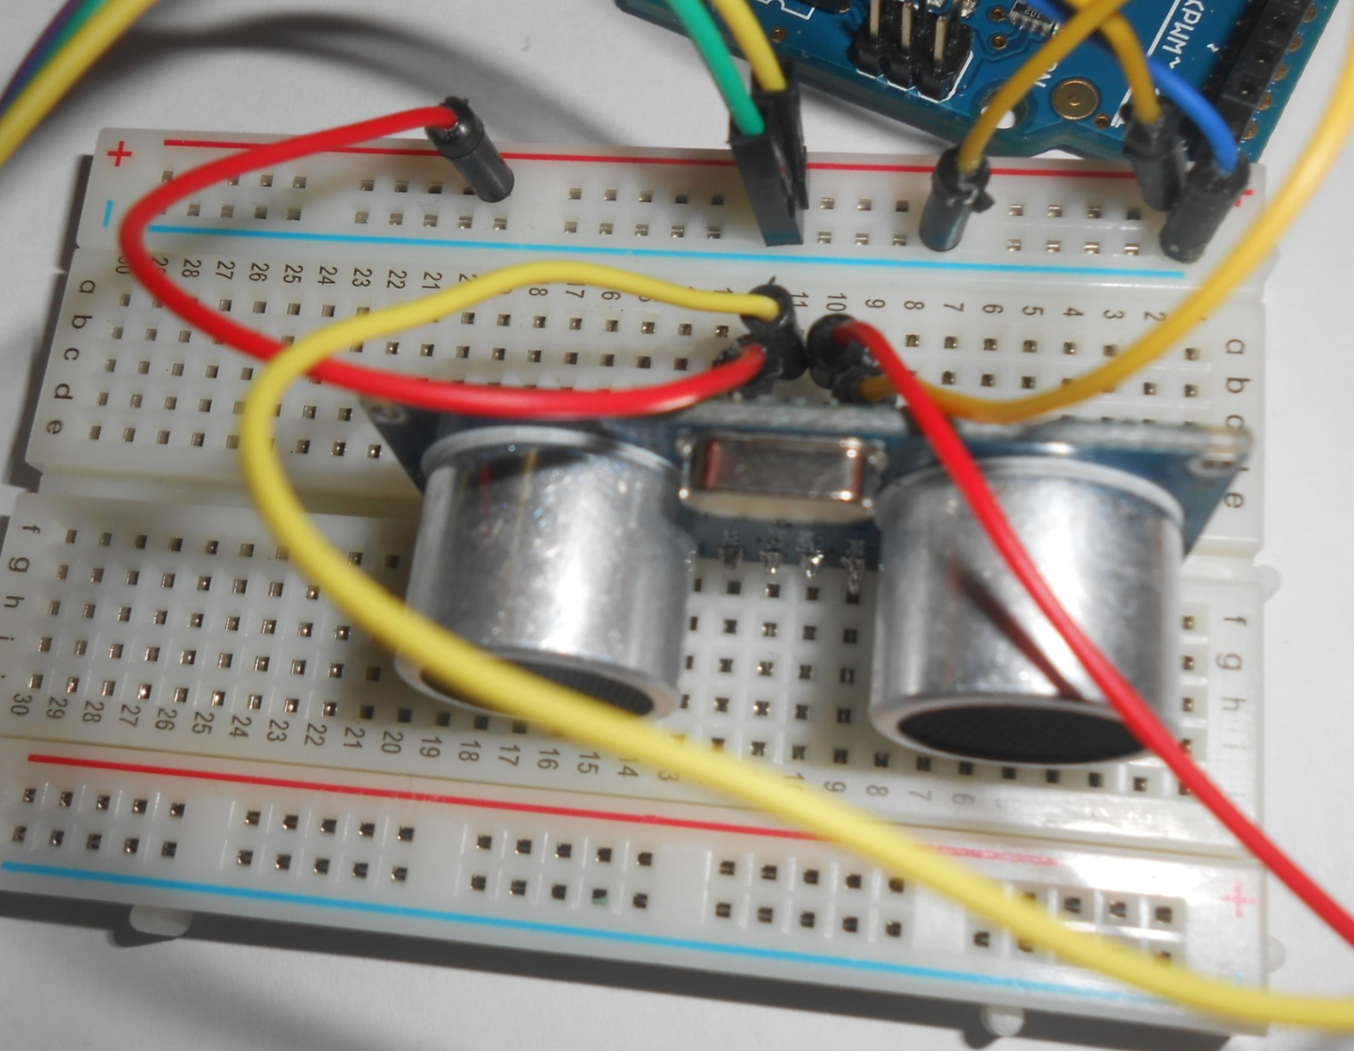
Build a Parking Sensor – Ultrasonic Sensor

Slide 4
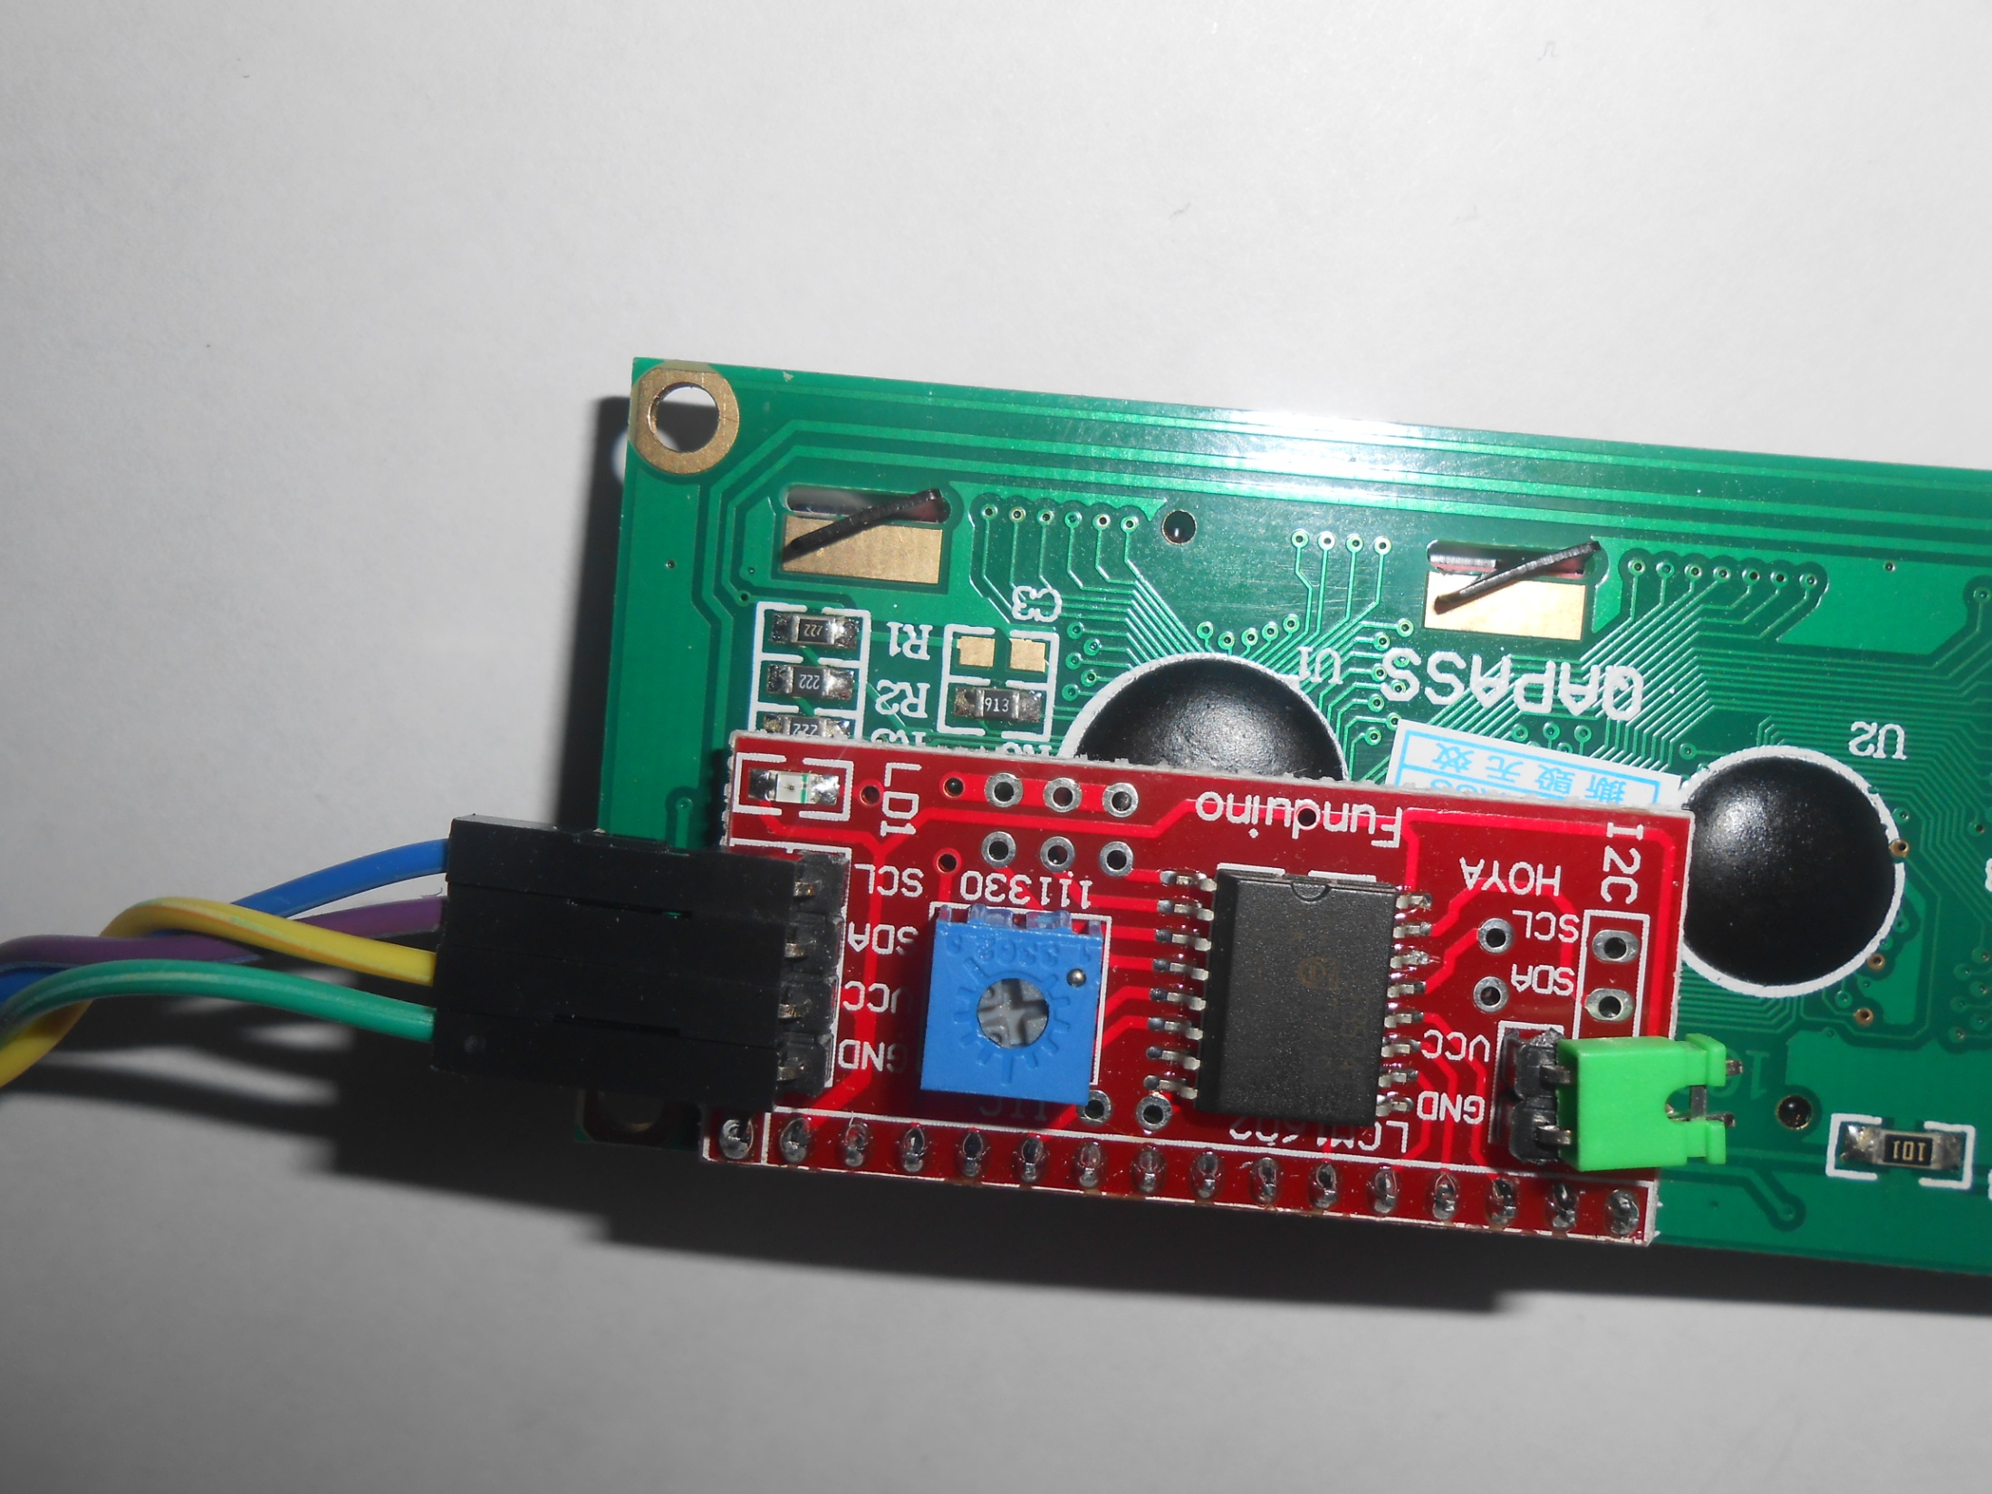
Build a Parking Sensor – LCD Screen (SainSmart)

Slide 5
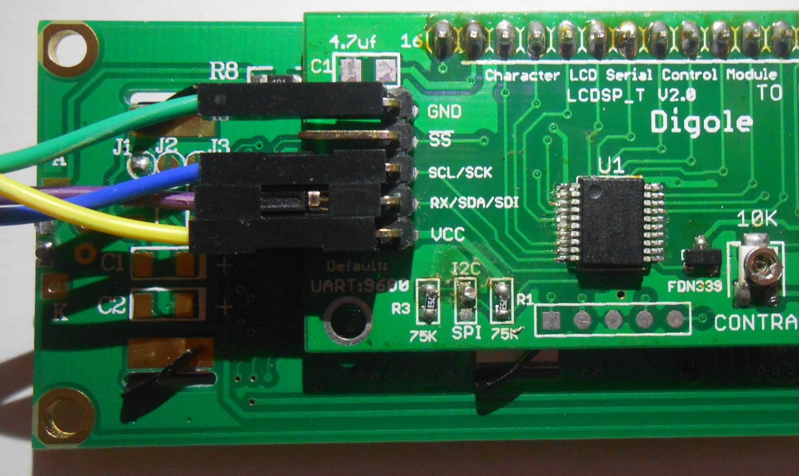
Build a Parking Sensor – LCD Screen (Digole)

Slide 6
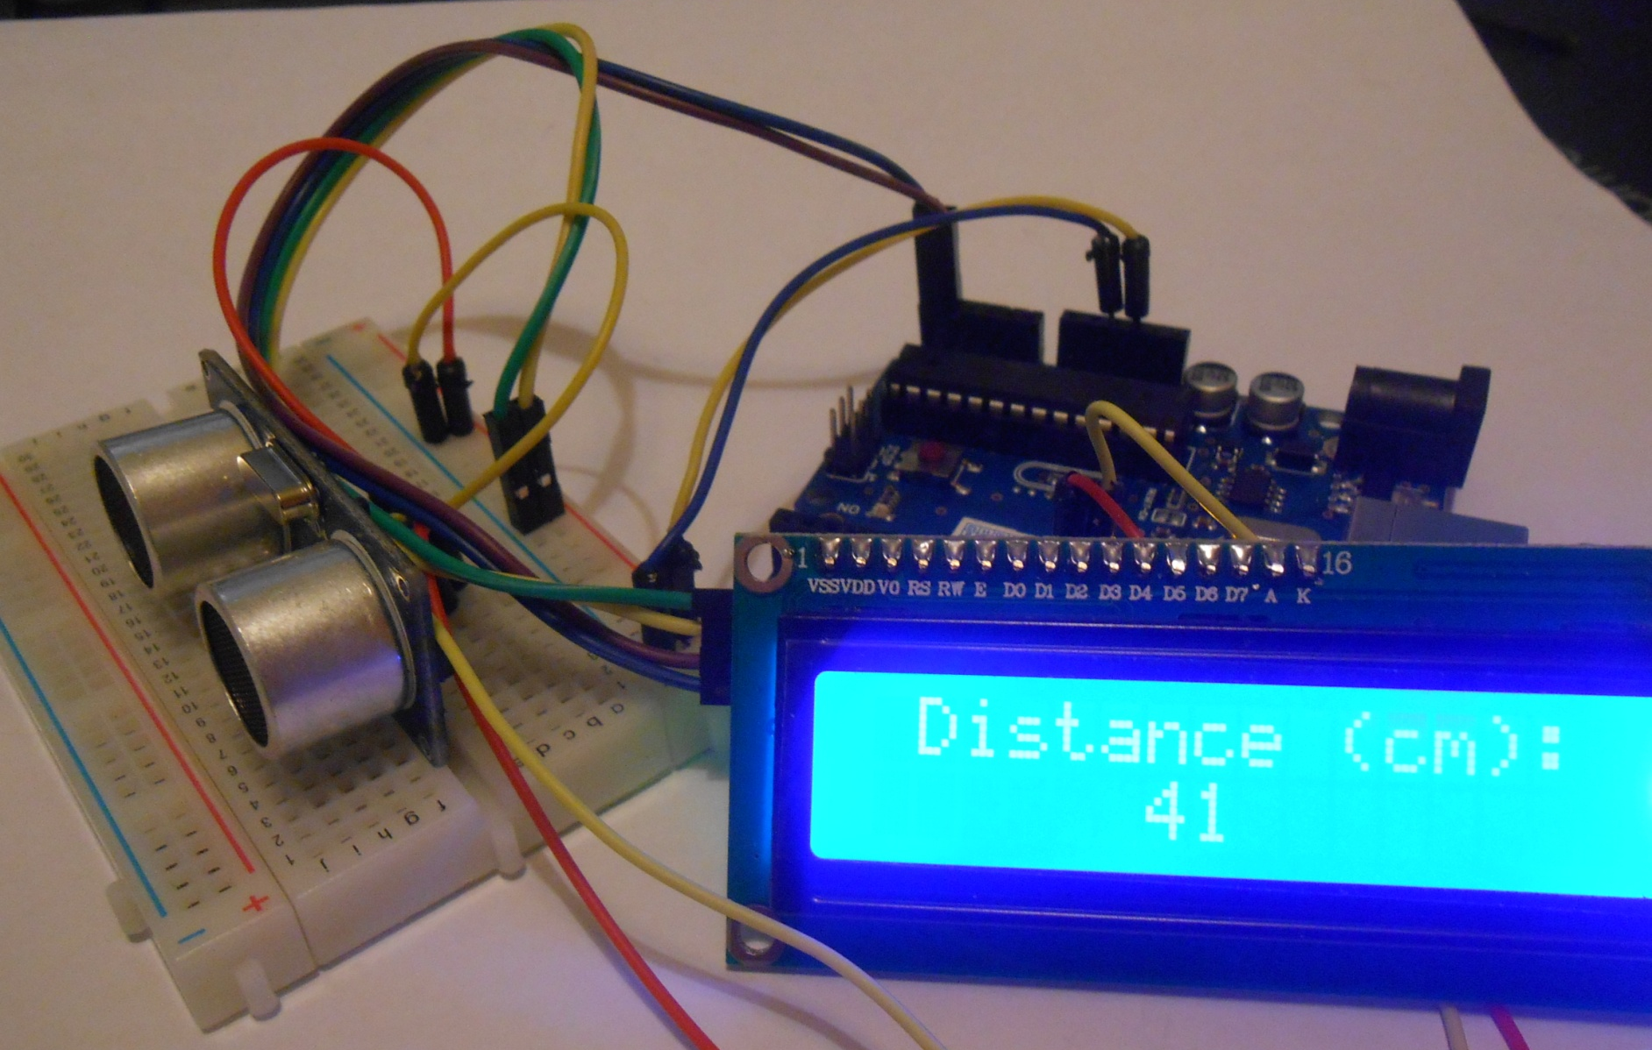
The Finished Parking Sensor

